Slide 1
Travel Mate
Francesco Boldrini, Ettore Ricci, Paolo Palumbo

Slide 2
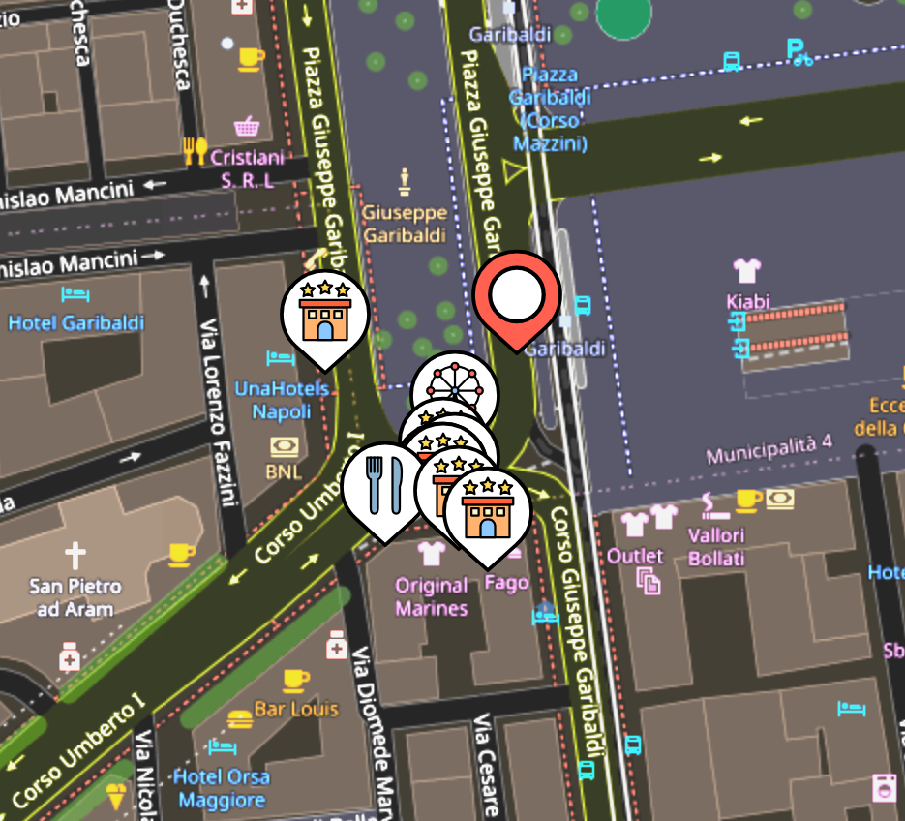
In a nutshell
Quickly search for nearby restaurants, hotels or attractions, all in one click – from car or from smartphone.
Simply listen to the AI overview and snap right where you want!
Exploit a powerful opportunity to get actual revenue in if you're a restaurant or a hotel owner!

Slide 3



Business Model
Ad-supported Model
Pay-per-click
Low AI costs
Completely free application, Ads initially sustain costs – users can pay to remove them
Partners pay for sponsored spots: each click brings them a customer and us revenue
Low costs for our AI, but decreasing as devices support running the model locally

Slide 4


The competition
 | Travel Mate | Google Maps Apple Maps | Booking TripAdvisor | Waze | Tesla
In-car suggestions
AI overview
Does not interrupt existing navigation
Voice explanations
One-click fetch
Standalone App
Has car version

Slide 5
Feasibility Analysis
Scope & Purpose
Market Feasibility
Technical Feasibility
Legal Feasibility
Financial Feasibility
Operation Feasibility
Timeline Feasibility
Risk Assessment
Conclusions

Slide 6
Scope & Purpose
Problem statement:
No simple way to find nearby places to rest or eat, while driving.
Target users:
Drivers, both commercial and leisure travellers.
Core features:
AI Overview
Real-time updates
Regulation-compliant

Slide 7
Market Feasibility
Anyone with a smartphone or smart vehicle:
250+ million Android Auto vehicles, about 16.9% of all cars – including 3rd world countries, about 28% otherwise.
https://9to5google.com/2025/05/14/android-auto-is-now-on-over-250-million-cars/​
https://en.wikipedia.org/wiki/List_of_countries_and_territories_by_motor_vehicles_per_capita

Slide 8
Technical Feasibility
Core Technologies:
React
Docker
Ollama
Python
The application is seamlessly scalable across devices and can be used by any device capable of navigating the web.

Slide 9
Legal Feasibility
GDPR and CCPA compliant:
No personal data stored
Only account ID linked to payments
Licensing:
Use of open licenses only
Limited use of Tripadvisor/Maps APIs

Slide 10
Financial Feasibility
Main cost factors: (worst-case)
- Variable costs (0.005228$/Req.)
gpt-4o-mini: 0.15$/Mil in, 0.60$/Mil out
Google API call: 0.00512$/Req.
Fixed costs
AWS Fargate: ~300$/month with ~100k users
Sponsorship campaign: $80k to $90k in the first year

Slide 11
Financial Feasibility
Revenue per click on sponsored link: 0.94$
Click Through Rate for Break Even Point on variable costs: 0.556%
Then we would need only 320 more clicks to break even on fixed monthly costs.
Our kind of ads can expect from 5% to 10% CTR.
At a 5% CTR with 100k users/month, we would break even on the initial investment in 19 months, as an extremely pessimistic estimate.

Slide 12
Financial Feasibility
Leveraging simple caching technologies, most of the results in crowded zones are not subject to API or LLM costs.
Simulations indicate an average of 70.55% API calls saved in a territory like Tuscany
This means that on average the BEP on VC is at 0.164%.

Slide 13
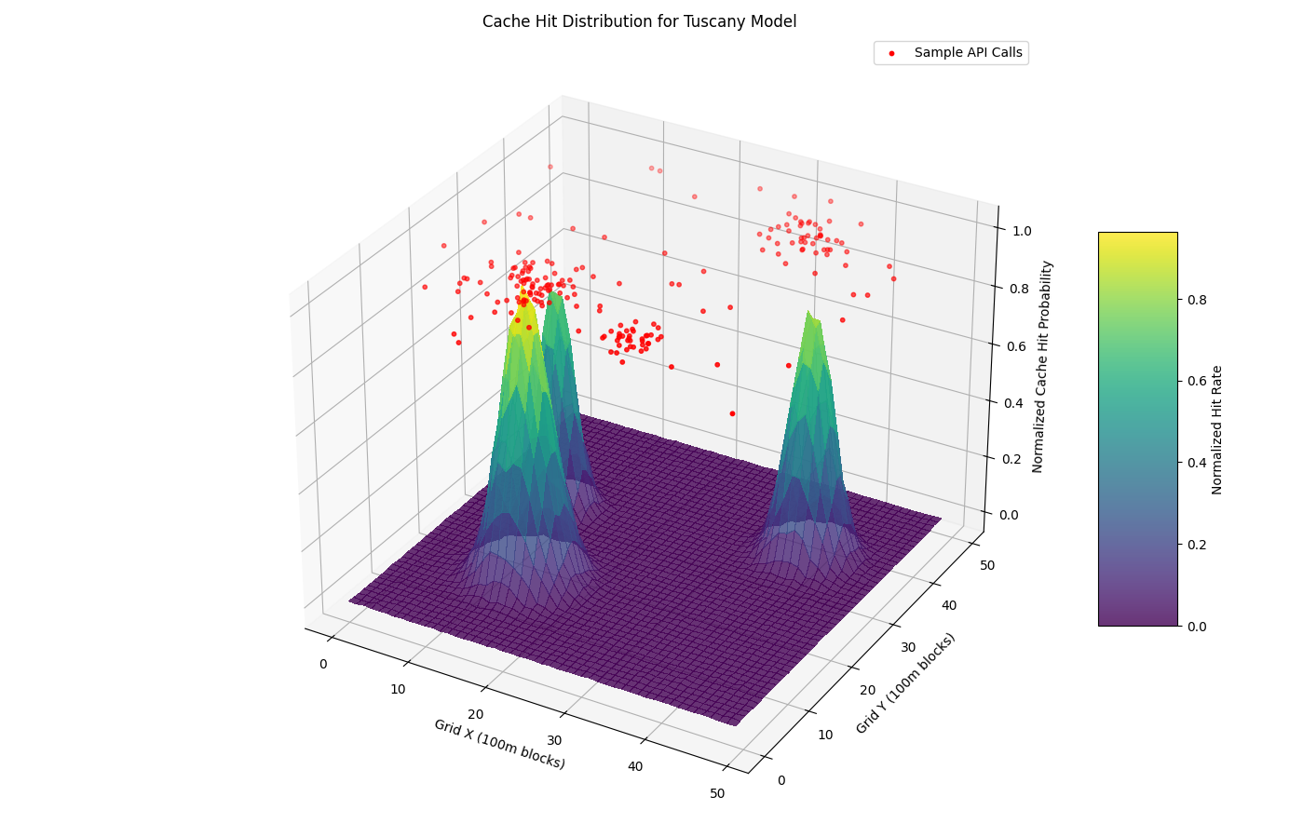
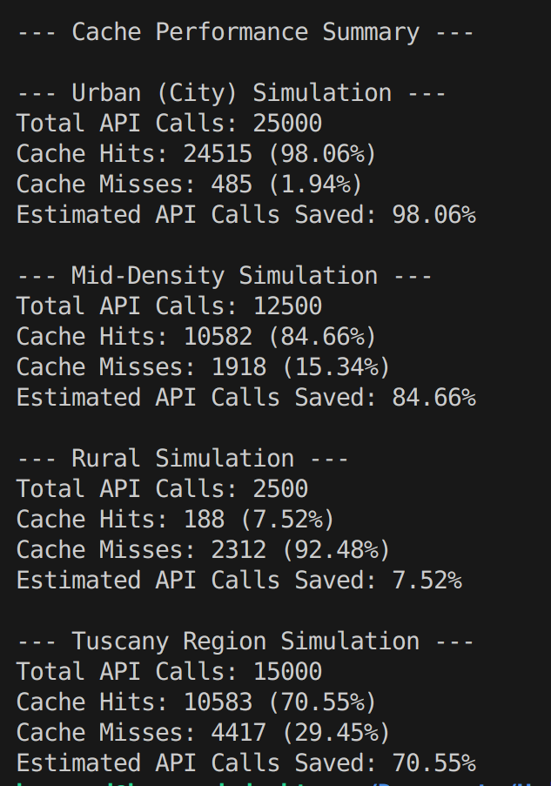
Financial Feasibility

Slide 14
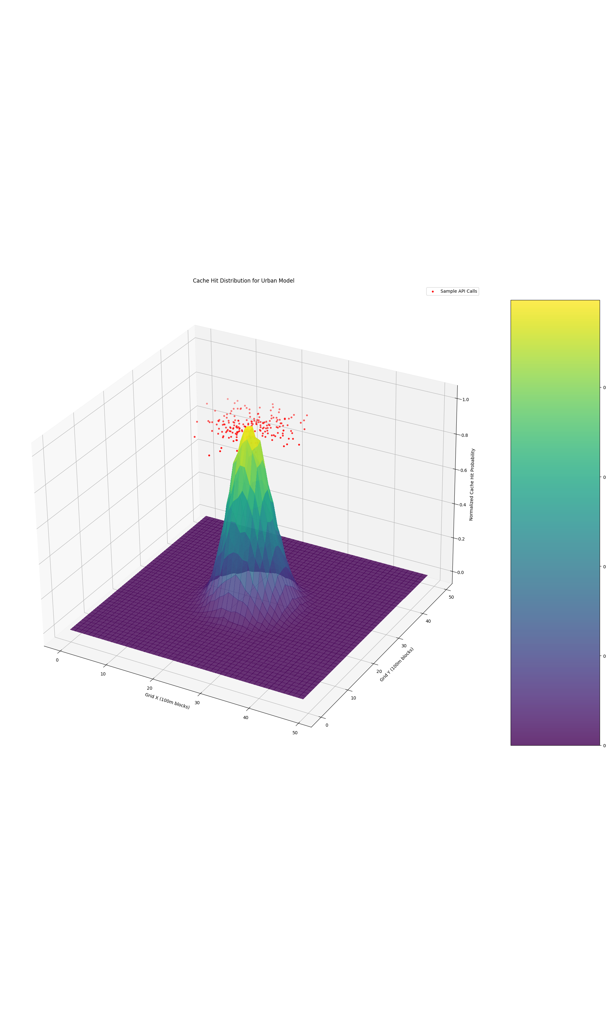
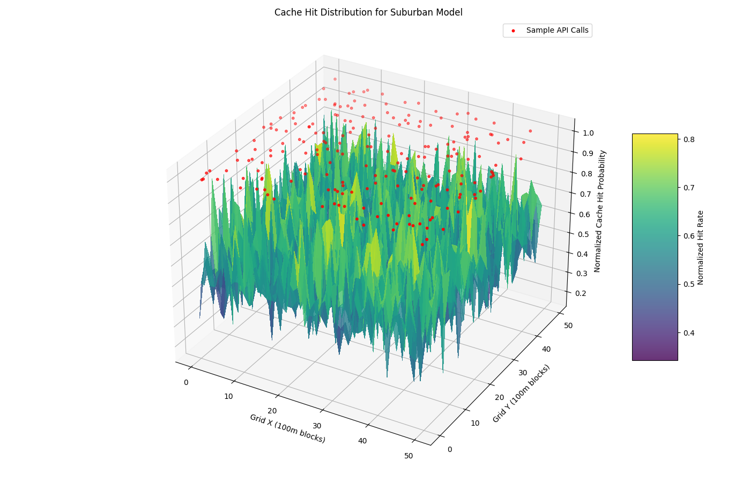
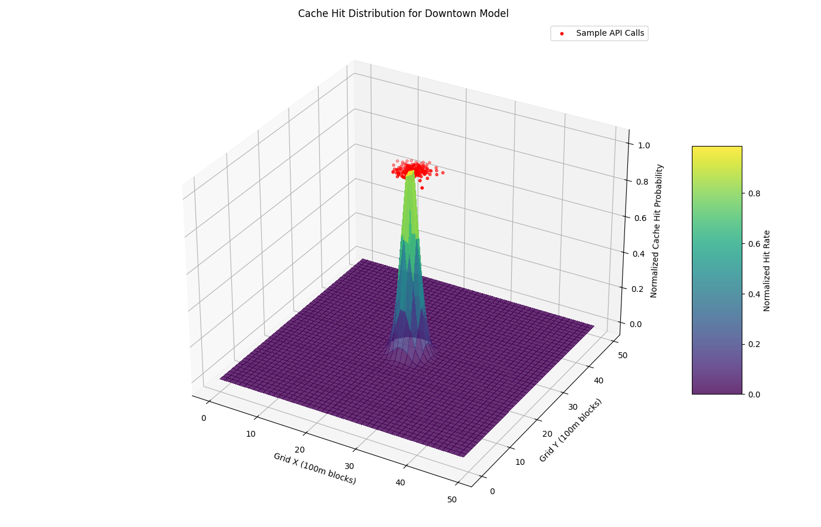
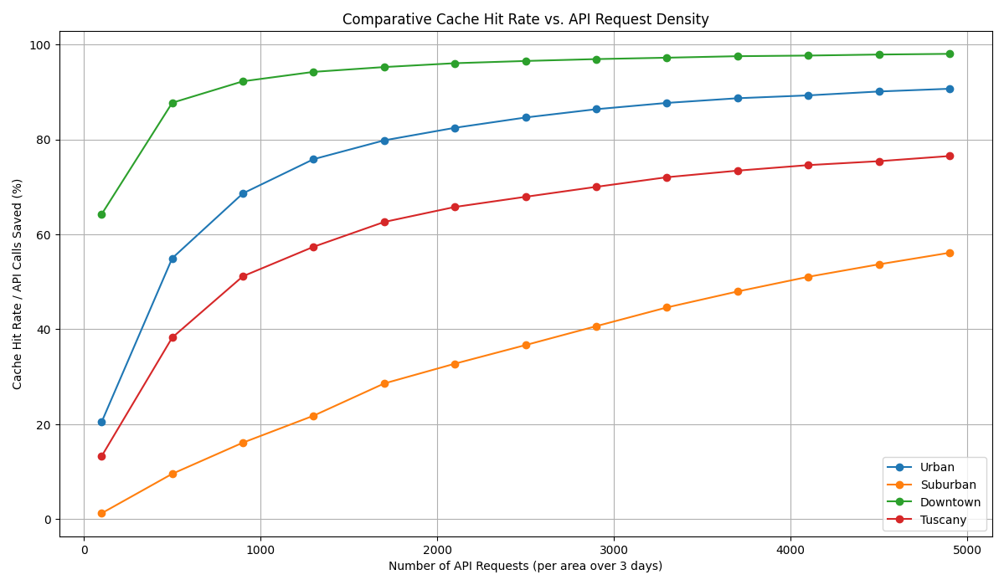
Financial Feasibility

Slide 15
Business model
The application is free to download
Direct financing of local activities through sponsor packages
Involvement of hotel, restaurants, enstablishments and touristic experiences providers
Direct offline promotion (QR codes, hotel receptions) + localized digital campaigns

Slide 16
The start-up model
Phase 1- Launch (0-12 months)
Objective: reach 100.000 downloads and expand covered territory.
Most of the investment is in marketing:
High costs: $80.000 - $90.000
Low sponsorship revenue - initial objective: $50.000 - $60.000
Expected loss in the first year: around $30.000 - $40.000

Slide 17
Growth
Phase 2 – Growth (12-24 months)
Objective: consolidate the number of sponsors and increase the ROI.
Marketing costs decrease by 20%-30% thanks to organic growth and word of mouth
Earnings increase with more businesses joining in, more packages, events
Break-even forcasted by month 18-24

Slide 18
scalability
Fase 3 – scalability (after 24 months)
Objective: Marginal growth of technical costs, rapid growth in sponsors
Earnings through local sponsors + premium features surpass technical costs + marketing
Positive profit margin, with the possibility to:
Expand geographically
Develop new app functionalities
Allow joining of more investors / strategic partners

Slide 19
Economic projection over 3 development phases
Phase | Costs | Earnings | Result
Launch | $90.000 | $50.000 | Loss -$40.000
2. Growth | $70.000 | $90.000 | Break-even
3. Scalability | $60.000 | $120.000 | +Positive margin

Slide 20
WP
WP 1 | MVP creation, beta testing | Start of activities: month 1 | end of activities: Month 6
Analysis of the state of the art, creation of initial product and initial testing
Month/Worker: 6. Months/Project Worker: 0. Months/Total: 6.
Objectives: Analyze the state of the art Create a MVP Gather feedback and adjust the MVP
General description of the work package: The activities of the first work package revolve around establishing proper initial feasibility and development of a base application.
Activities: State of the art: Research what the competition may be producing and enstablish the proper niche to target for the application's success. Creation of an MVP: Create a baseline application for initial feedback gathering and core feature showcase Beta testing and adjustment of the product: Gather user feedback and adjust features and overall polish of the application as the beta phase progresses.

Slide 21
WP
WP 1 | Deliverables
D1.1: Report on the state of the art D1.2: MVP application and overall base system, to be used in future development D1.3: Polished application, ready for launch to the general public and ready with most features
Control points: P1.1: Research results in a concise report P1.2: Application code and documentation
Total costs $24.000
Hired workers: N. 1 Full stack senior DevOps/ML developer: Cost 24000$, Months/worker: 6

Slide 22
WP
WP 1 | t1 |  |  | t2 |  |  | t3 |  |  | t4 |  |  | t5 |  |  | t6
Activity 1.1
Activity 1.2
Activity 1.3

Slide 23
WP
WP 1
Equipment: -
Materials and their use in the WP:
-
Project workers: -
Technical competences: use of Machine Learning, Python, React, Kubernetes, Git, Node.Js, Javascript, HTML, CSS.

Slide 24
WP
WP 2 | Launch, road to 100k users | Start of activities: month 7 | end of activities: Month 18
Launch of the product, advertisement campaigns, initial scaling, improving on feedback
Month/Worker: 24. Months/Project Worker: 0. Months/Total: 24.
Objectives: Launch the application Scale and improve upon feedback Gather the first direct sponsors
General description of the work package: The package aims to launch the application and establish the initial application's footprint and start a revenue flow
Activities: Launch the application: Launch the application s.t. it is available to the public and its promotional campaign Scale and improve upon feedback: Leverage caching to reduce API costs and polish the application/add features based on feedback Gather the first direct sponsors: Register the first customers among restaurants and hotels which directly want the app's visibility

Slide 25
WP
WP 2 | Deliverables
D2.1: Launch download reports and advertisement effectiveness reports D2.2: Caching and API costs report D2.3: Earning Report
Control points: P2.1: Download and use statistics P2.2: Earning analysis
Workforce costs: $84000, Advertisement cost: $42000, Total Cost: $126000
Hired workers: N. 1 Full stack senior DevOps/ML developer: Cost 48000$, Months/worker: 12 N. 1 Advertisement, PR specialist: Cost: 36000$, Months/worker: 12

Slide 26
WP
WP 2 | t1 |  |  | t2 |  |  | t3 |  |  | t4 |  |  | t5 |  |  | t6
Activity 2.1
Activity 2.2
Activity 2.3

Slide 27
WP
WP 2
Equipment: -
Materials and their use in the WP:
-
Project workers: -
Technical competences: use of Machine Learning, Python, React, Kubernetes, Git, Node.Js, Javascript, HTML, CSS, adsense, basic accounting, public relationship.

Slide 28
WP
WP 3 | scalability | Start of activities: month 19 | end of activities: Month 24
Optimization of the product,
Month/Worker: 18. Months/Project Worker: 0. Months/Total: 18.
Objectives: Scale operations Maintain the application Enhance customer care
General description of the work package: the activities revolve around scaling up the product and adjusting for the increase in customers
Activities: Scale operations: Scale the application to meet the demand and reduce costs Maintain the application: Limited expertise required to maintain the application and manage scaling Enhance customer care: Provide a dedicated person for the growing userbase, capable of helping the advertisement expert

Slide 29
WP
WP 3 | Deliverables
D3.1: Scaling report and economy of scale in API costs D3.2: Application vulnerability and maintenance report D3.3: Customer reviews summary
Control points: P3.1: Earning Analysis P3.3: Average rating on the web
Workforce costs: $56000, Advertisement cost: $24000, Total Cost: $80000
Hired workers: N. 1 Full stack senior DevOps/ML developer: Cost 24000$, Months/worker: 6 N. 1 Advertisement, PR specialist: Cost: 18000$, Months/worker: 6 N. 1 Customer care agent: Cost: 14000$, Months/worker: 6

Slide 30
WP
WP 3 | t7 |  |  | t8
Activity 2.1
Activity 2.2
Activity 2.3

Slide 31
WP
WP 3
Equipment: -
Materials and their use in the WP:
-
Project workers: -
Technical competences: use of Machine Learning, Python, React, Kubernetes, Git, Node.Js, Javascript, HTML, CSS, adsense, basic accounting, public relationship.

Slide 32
Operational Feasibility
Key figures for the application:
Our Dev-Ops engineer
The advertisement and PR specialist

Slide 33
Operational Feasibility
Operations can easily scale automatically on Kubernetes cluster thanks to the containerized architecture.
The app is easy to maintain thanks to the simple framework used.

Slide 34
Timeline Feasibility
How we’ll scale in the future
JUL 2025
Sep 2025
Jan 2026
Build core app features and interfaces to validate concept and gather early feedback from selected users.
Develop essential functionalities for market testing, integrate user feedback, and prepare app for initial limited release.
Release to general public, launch advertisement campaign, sale of google ads and lifetime no-ad subscriptions for initial financing.

Slide 35
Two-year action plan
Prototype
development
MVP
development
Beta Testing
2025
Jan
Feb
Mar
Apr
May
Jun
Jul
Aug
Sep
Oct
Nov
Dec
Release
Rollout
2026
Jan
Feb
Mar
Apr
May
Jun
Jul
Aug
Sep
Oct
Nov
Dec

Slide 36
Risk Feasibility
Thanks to the platform independent nature of the app, we can avoid all technical risks.
No personal user data is stored by design so there are no risks regarding privacy regulations.
Dependency from LLM API costs can be avoided with self-hosting.
Variations in Google places API costs can affect our income.

Slide 37
Conclusions
Given our flexible and scalable architecture, along with a broad target market, we believe this solution represents a strong investment opportunity with high growth potential.

Slide 38
Why us?

Slide 39
High-value
Travel Mate
competitors
Aimed at automotive, non-planned Fixed 0.94$ commission per navigation No hidden fees.
Booking.com 18% or more on commissions on each stay
Other platforms: high-commission, focused on planned stays

Slide 40
Our competition graphic
convenient
Travel mate
expensive
Booking
Tripadvisor
affordable
Maps
WEB search
Inconvenient​

Slide 41
Our team
Francesco Boldrini
Ettore ricci
Paolo Palumbo

Slide 42
Thank you

